Slide 1
PHM Project – Report Week 4 PHM – Methodologies Review
Truong Hoang Linh
Oct 28, 2021

Slide 2
Outline
Feature extraction methodologies | Time domain Frequency domain Joined Time-Frequency domain Python implement
Review paper | Analysis and comparison of multiple features for fault detection and prognostic in ball bearings Highly Accurate Machine Fault Diagnosis Using Deep Transfer Learning A new dynamic predictive maintenance framework using deep learning for failure prognostics

Slide 3
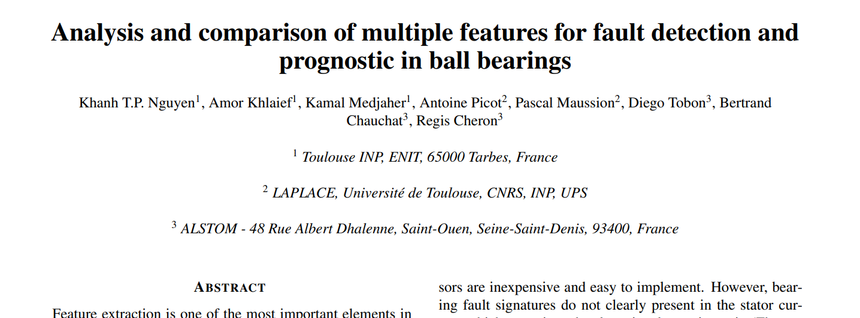
Feature extraction

Slide 4
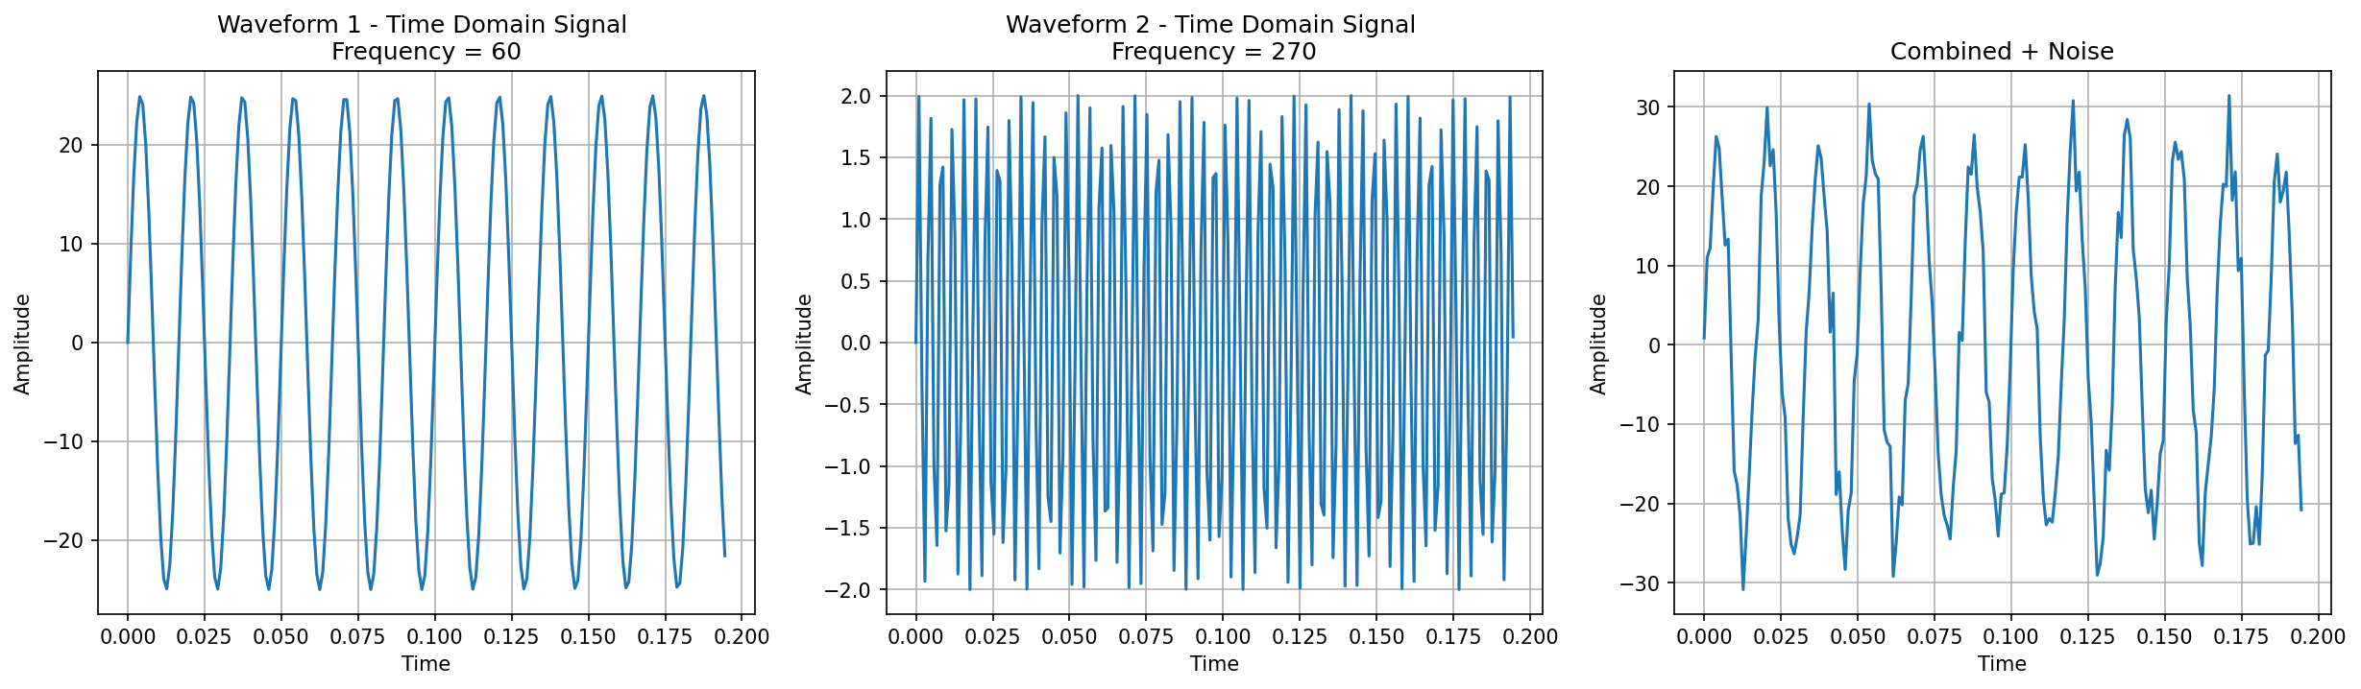
Initial time series data
Mean = 0.012774085610385788,
Max = 32.496363894223904,
Min = -34.528731533187816,
Variance = 323.67413924973584
RMS1 = 17.673353165411903
RMS2 = 1.413868253232953
RMS = 17.990950570411755

Slide 5
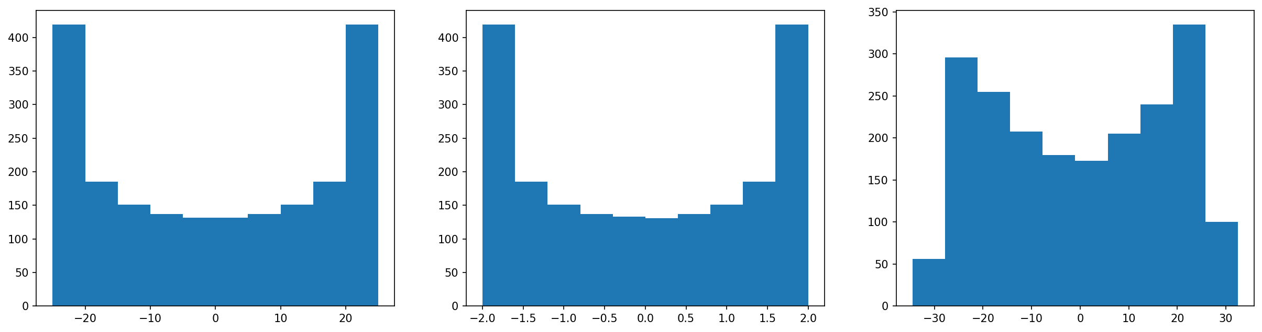
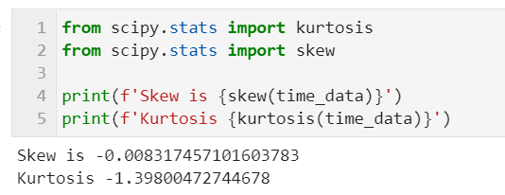
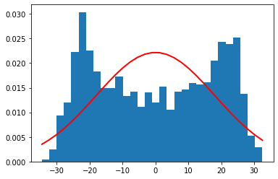
Skewness and Kurtosis

Slide 6
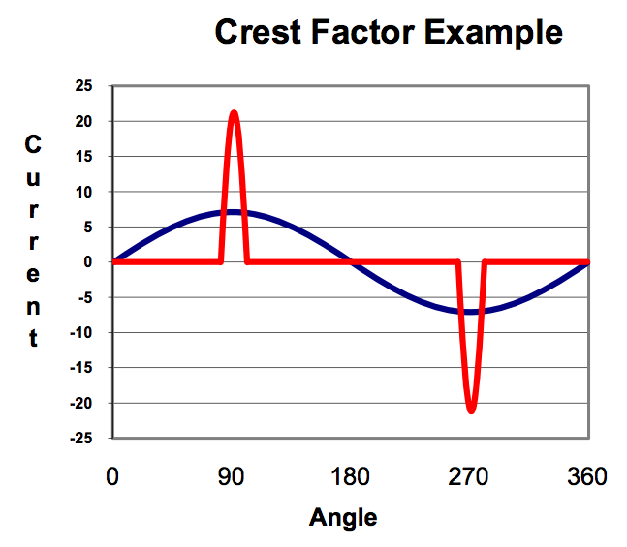
Meaning of features
Skewness → what mean in data?
Kurtosis
RMS
Crest factor (CF), Peak to Peak value (PP), Shape factor (SF), and Impulse factor (IF), are powerful to capture changes in the signal pattern of vibration when anomalies occur

Slide 7
Analysis in Frequency domain
Bearing condition because bearing defects generally generate characteristic frequencies in the vibration

